Slide 1
An analysis on US Political discussions on Reddit
Luke Dickson, Tom Finke, Gabriel Himmelein, Margarette Mendoza

Slide 2




Data collection
Data
Scope
Selection of Subreddits
Temporal Coverage
Enhanced Post Information
US political discussions on Reddit
Capture influential communities
Immediate trends and persistent topics
Unify and enrich insights across the dataset
Notes:
Plot 1:
Show a normalised number of comments per post based on the date the post was made
There a gradual increase as time progress – as the election approaches
A notable peak around August-September which is when allegations against Trump began to surface and he was convicted
Plot 2:
Shows the total number of comments on all posts based on date
Similar shape to the first plot – with a peak in the same spot
A linear model was fitted to this plot which shows a positive gradient – implies there could be a positive linear relationship

Slide 3
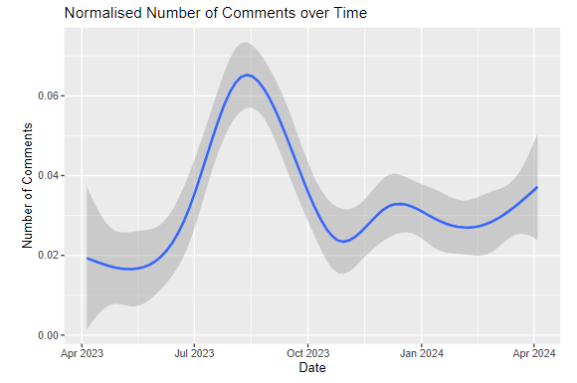
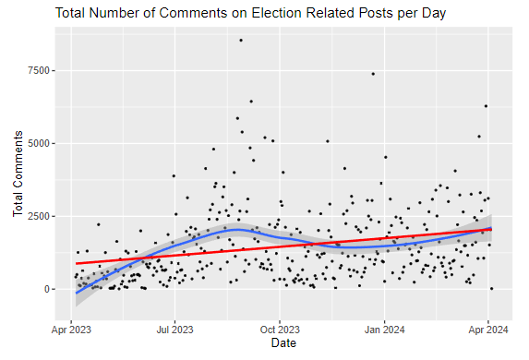
Plots -
Linear Models
Plot on Total Number of Comments on All Posts Each Day
Plot of Normalised Number of Comments on Posts Based on Date
Notes:
Plot 1 On the left shows the normalised number of comments per post based on the date the post was made
while plot 2 On the right there is the total number of comments on all posts for each date
In Both:
There a gradual increase as time progress – as the election approaches
A notable peak around August-September which is when allegations against Trump began to surface and he was convicted
A linear model shows a positive gradient – implies there could be a positive linear relationship
After background research, it was found that a Poisson Regression model was a better fit for our data type, so this plot is fitted with a Poisson Regression model.
Using these plots, as well as statistical analysis, enough evidence was reached to reject the null hypothesis and conclude that the number of
comments in electoral sub-reddits does increase as elections approach.
However, there is a large amount of variance in the created models – implying that there are other factors that contribute to this relationship and cause this randomness.

Slide 4
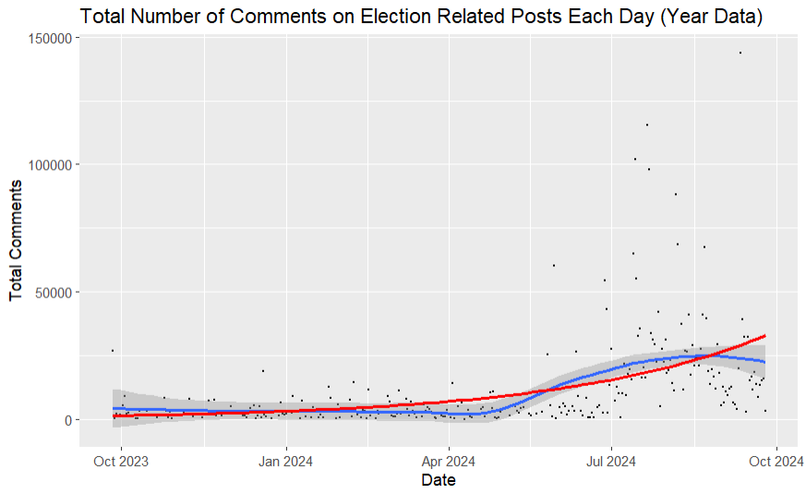
Plot -
Poisson Model
Plot of Total Comments on Each Day
(fitted with a Poisson Regression Model)
Notes:
After background research, it was found that a Poisson Regression model was a better fit for our data type, so this plot is fitted with a Poisson Regression model.
Using these plots, as well as statistical analysis, enough evidence was reached to reject the null hypothesis and conclude that the number of comments in electoral sub-reddits does increase as elections approach.
However, there is a large amount of variance in the created models – implying that there are other factors that contribute to this relationship and cause this randomness.

Slide 5


Network Analysis
Communities
Topics
Central users
Discover similar thinking groups of people
Gain insight into topics of discussion in communities
Discover central users within communities
Notes:
Plot 1:
Show a normalised number of comments per post based on the date the post was made
There a gradual increase as time progress – as the election approaches
A notable peak around August-September which is when allegations against Trump began to surface and he was convicted
Plot 2:
Shows the total number of comments on all posts based on date
Similar shape to the first plot – with a peak in the same spot
A linear model was fitted to this plot which shows a positive gradient – implies there could be a positive linear relationship

Slide 6
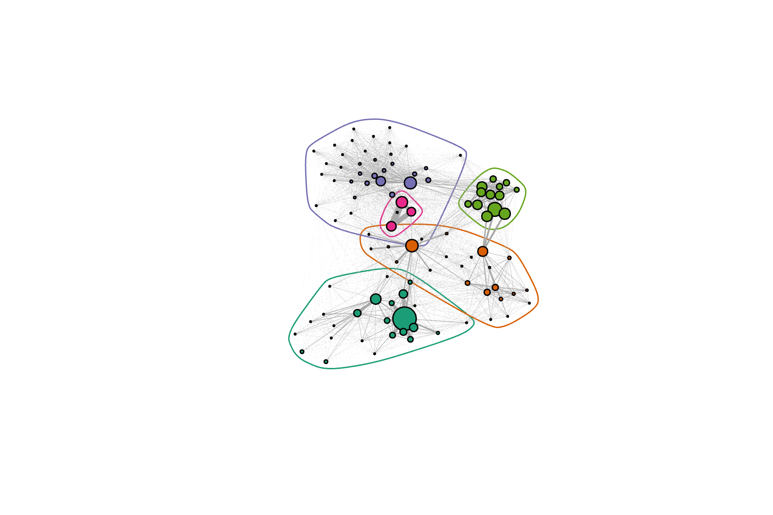
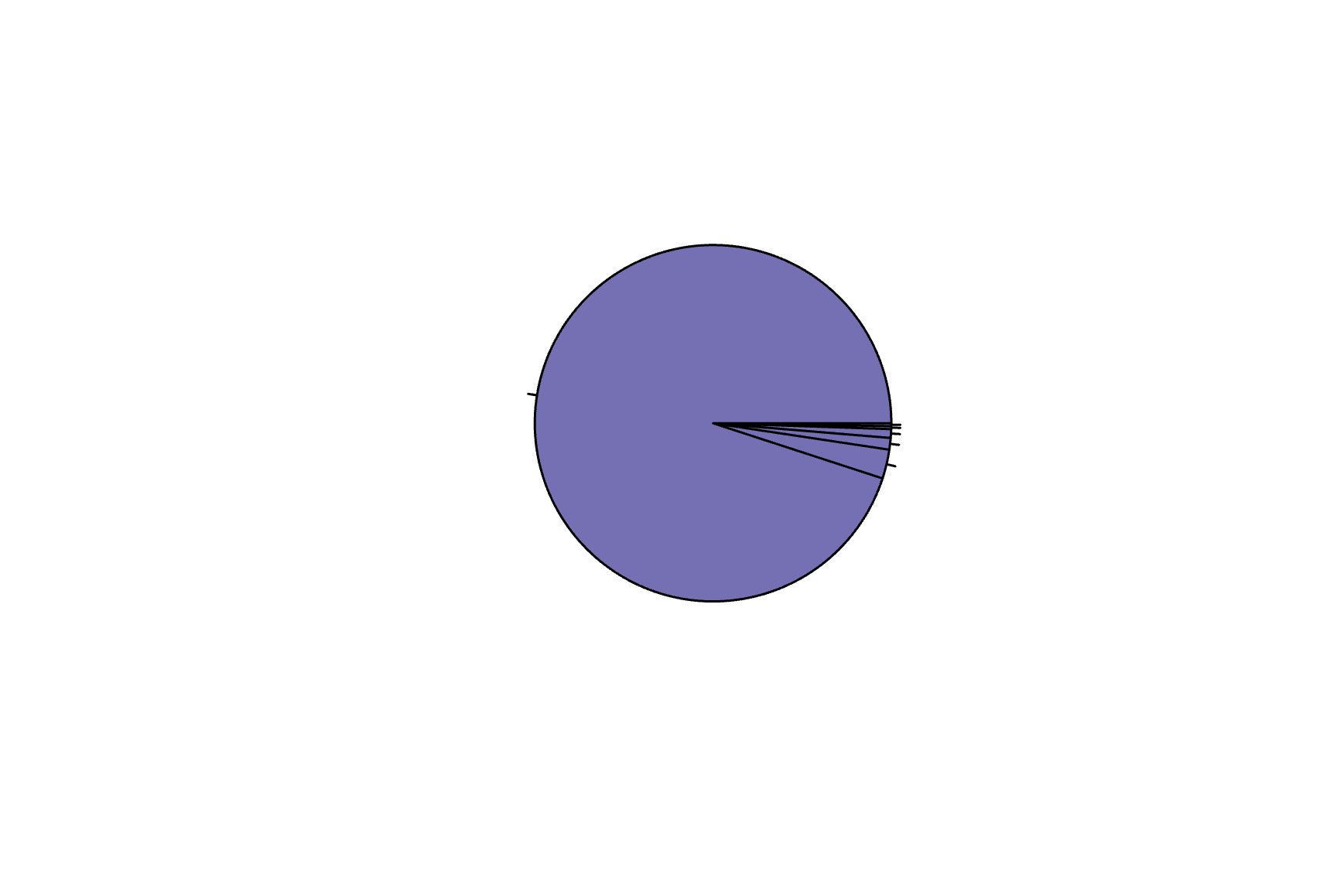
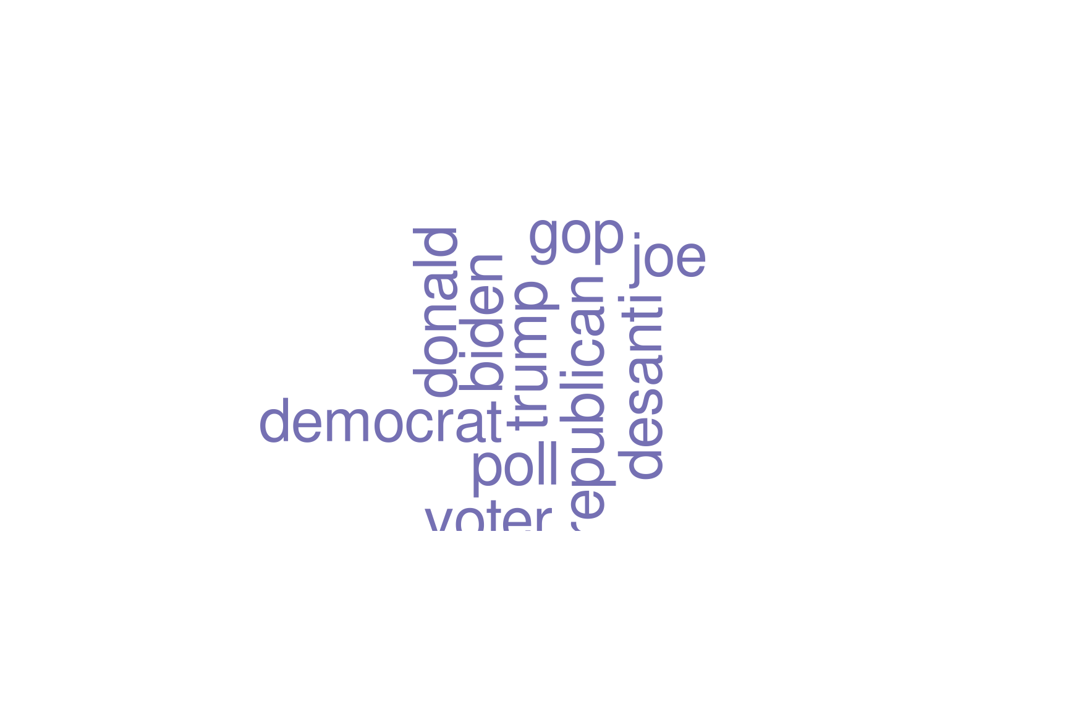
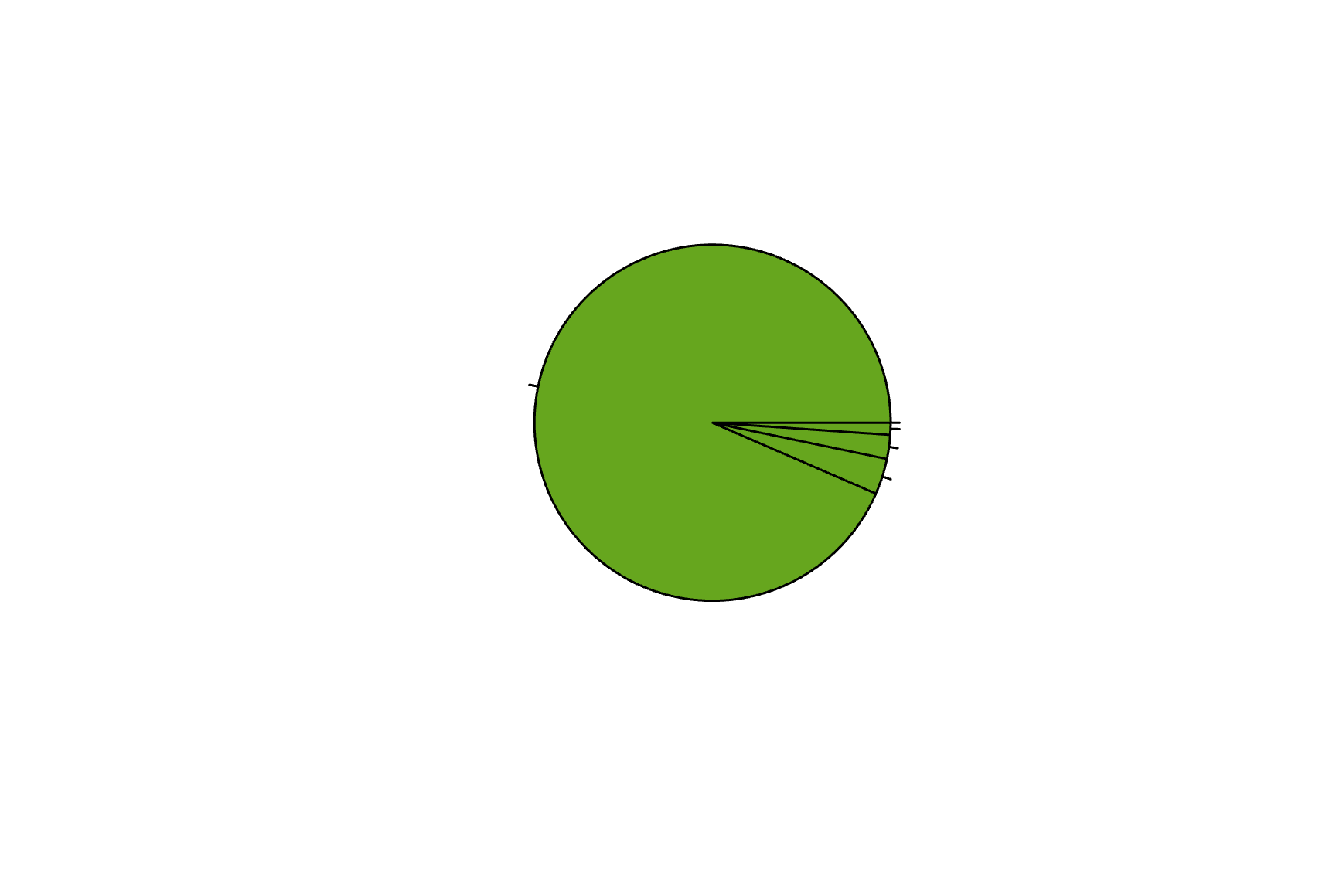
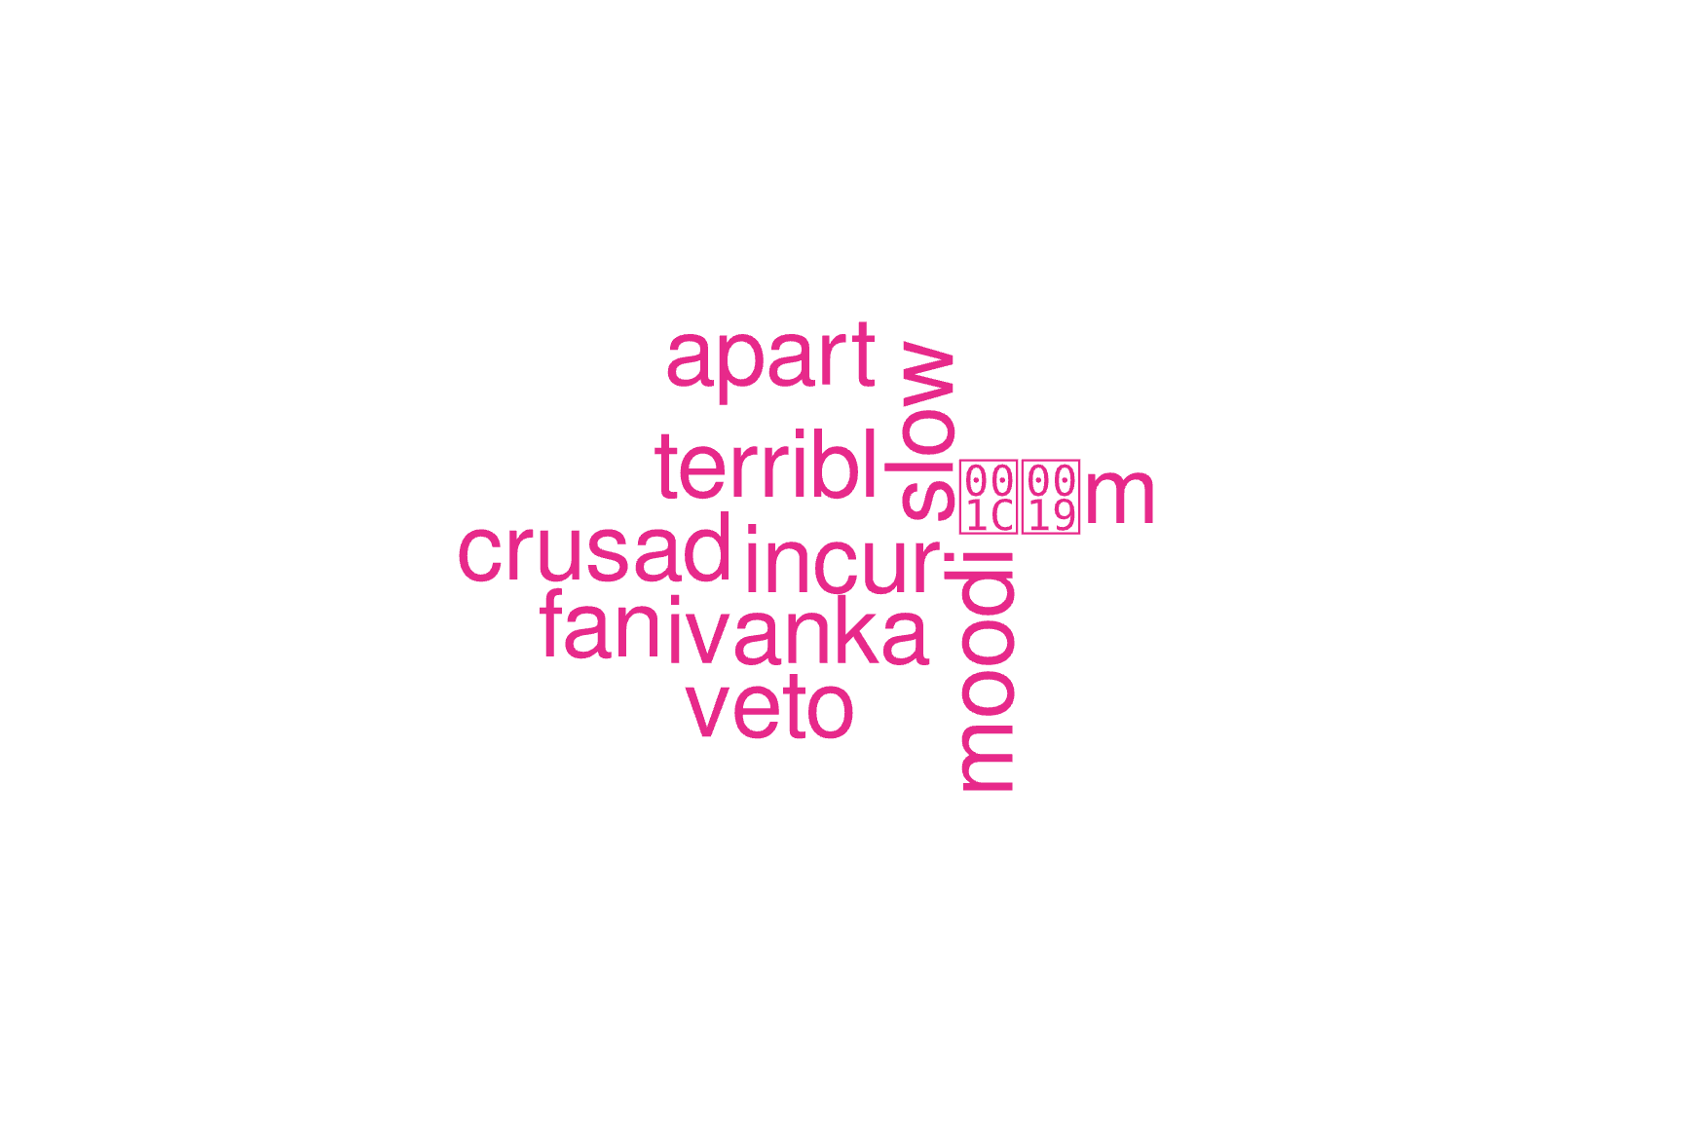
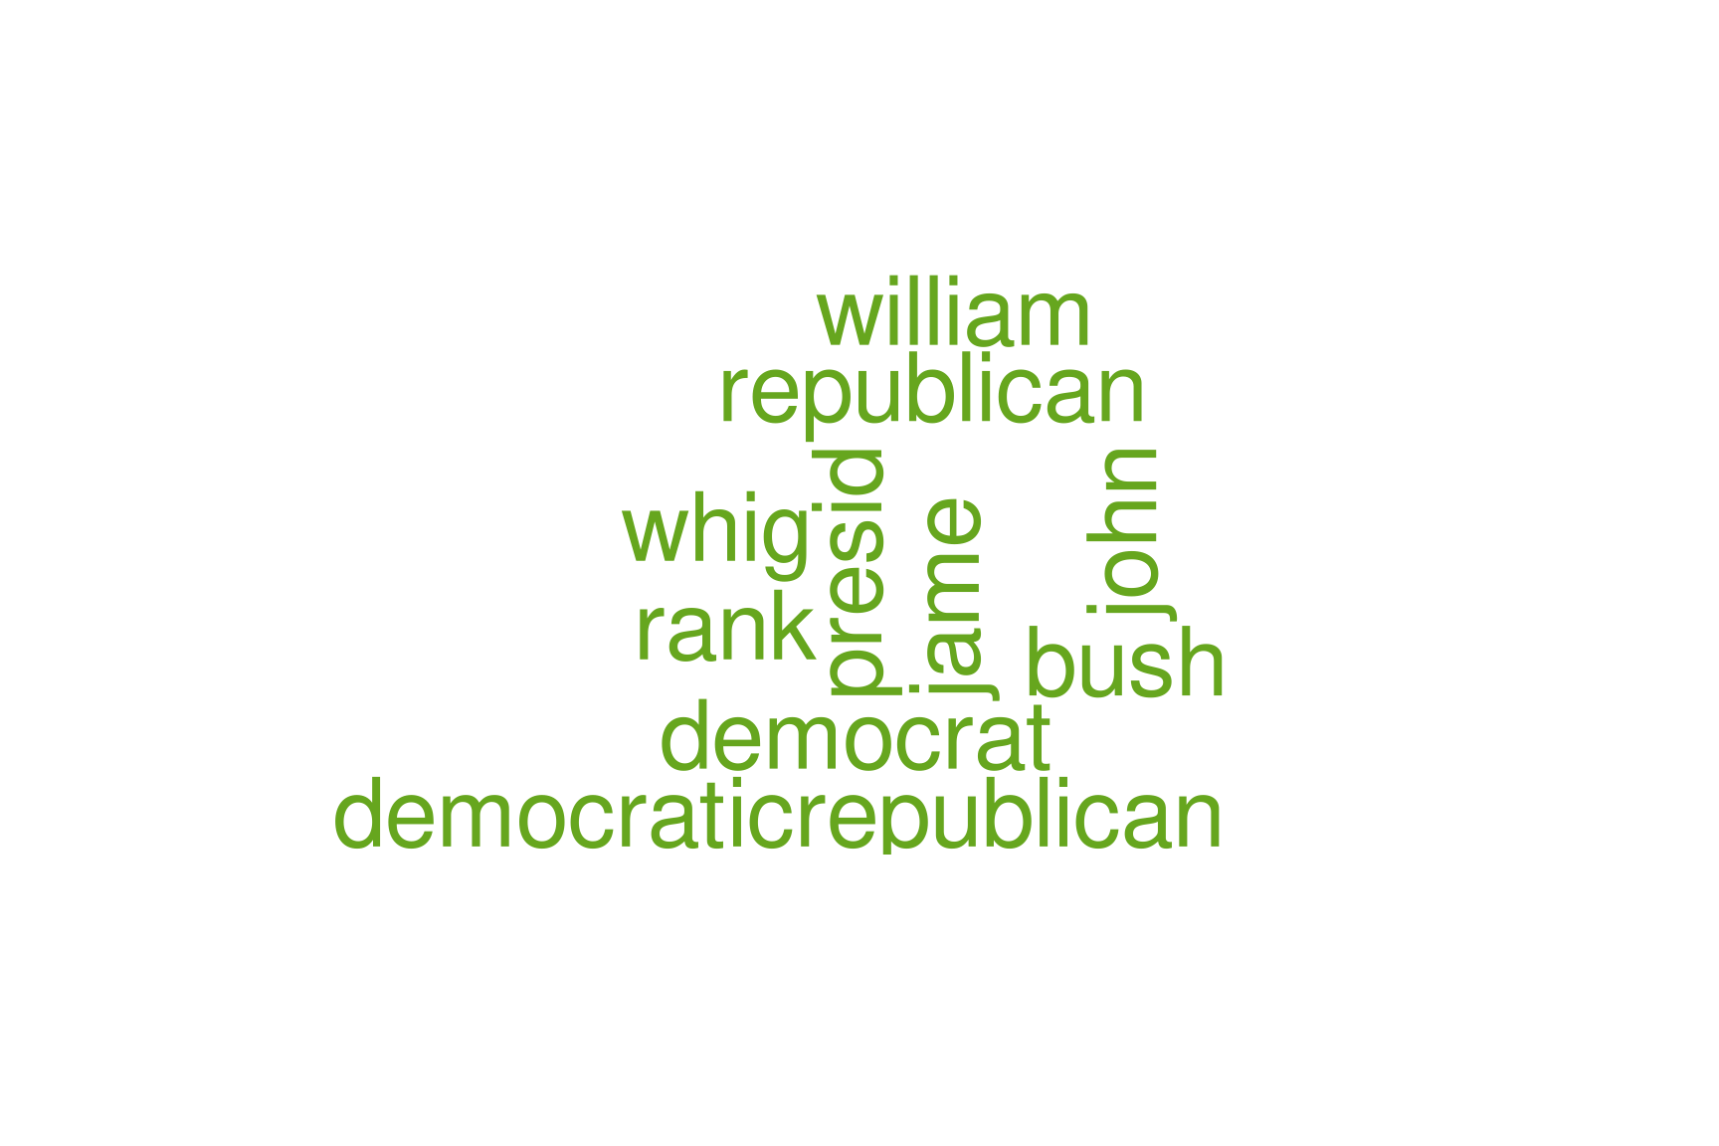
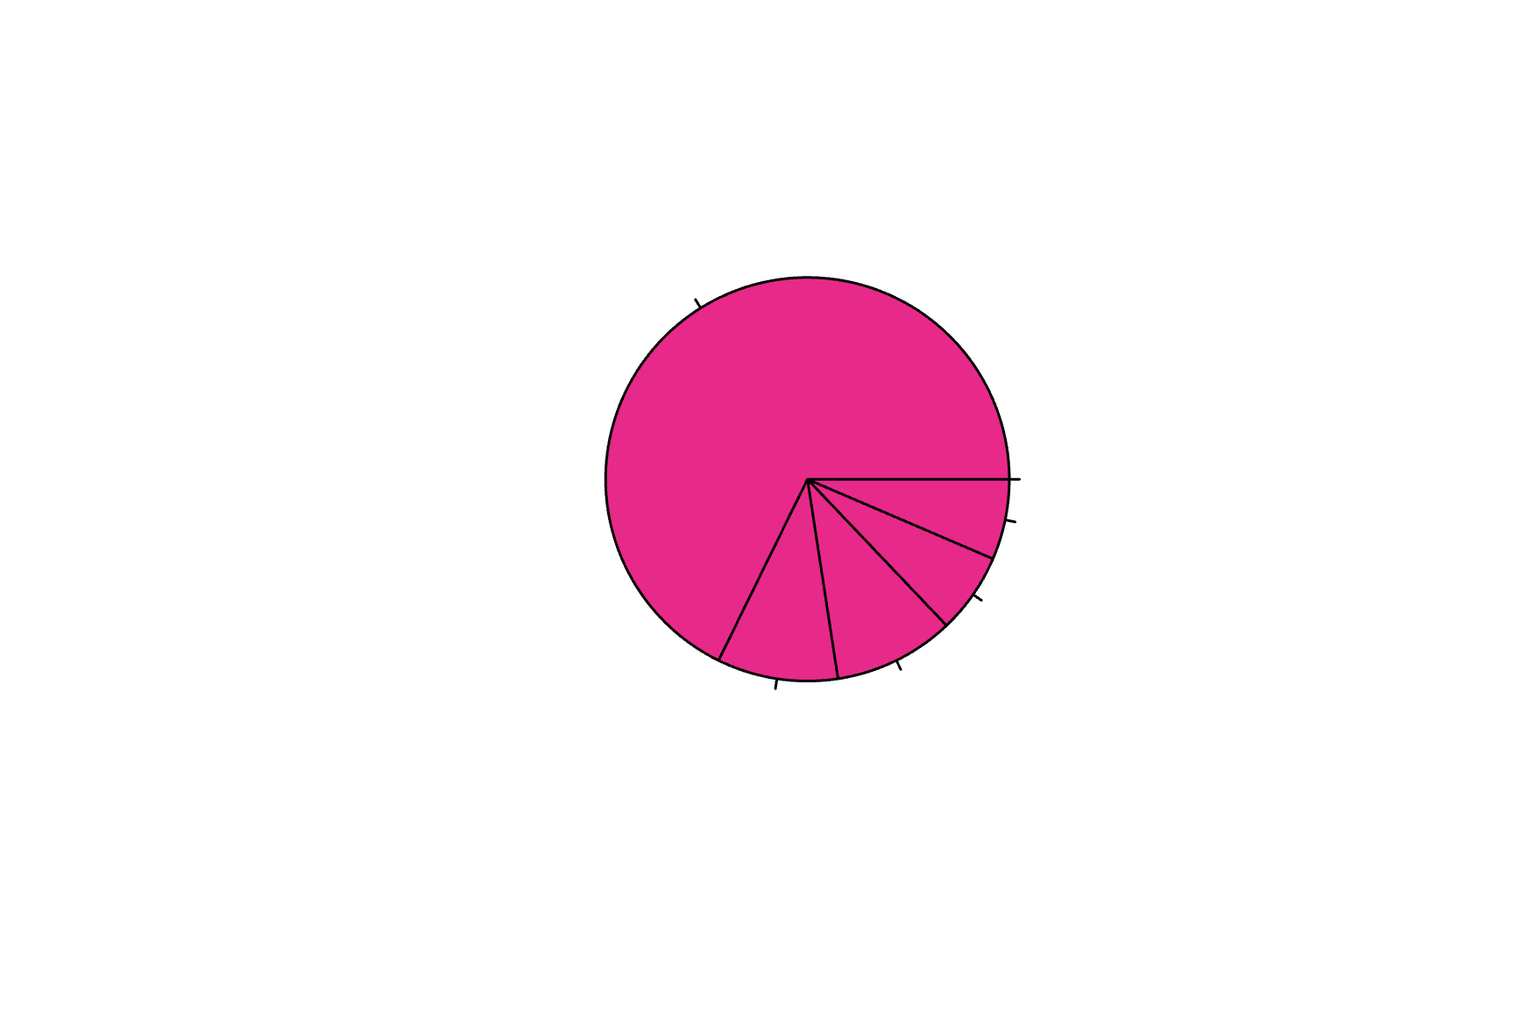
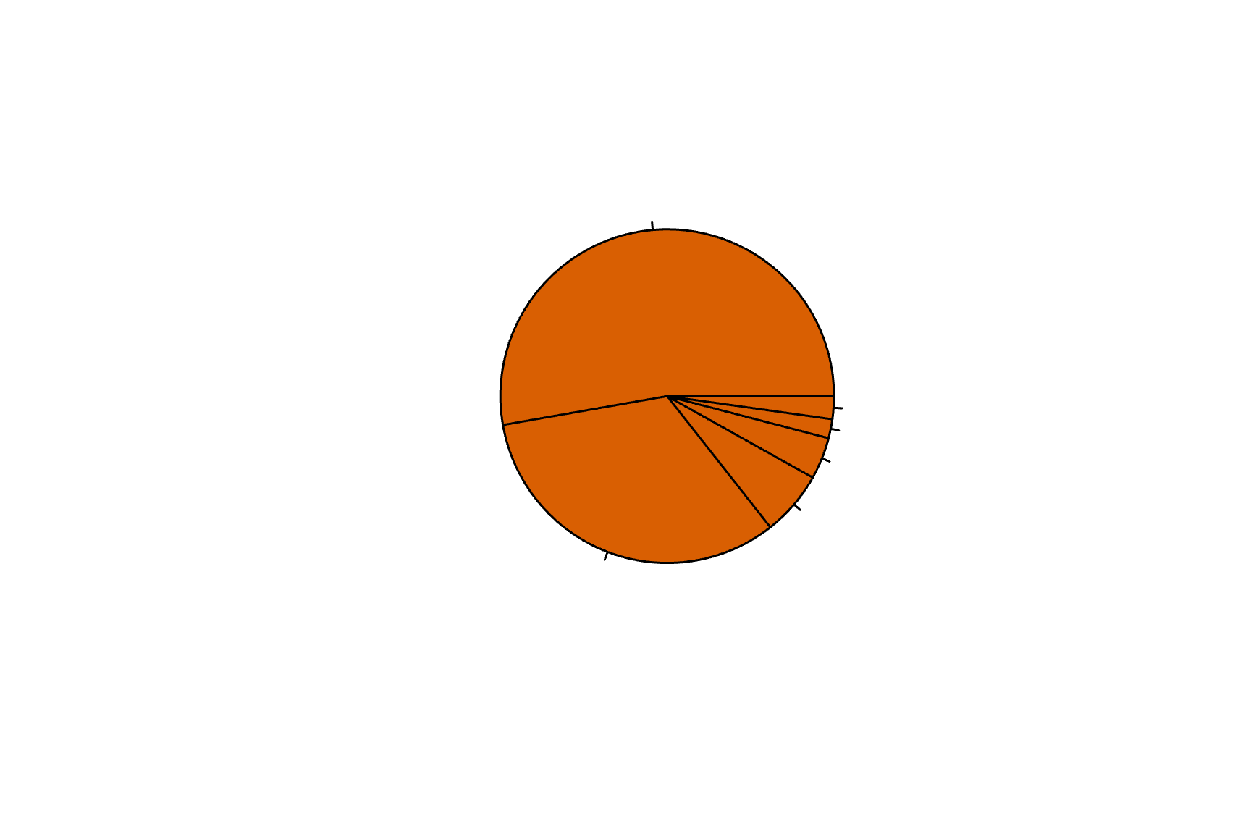
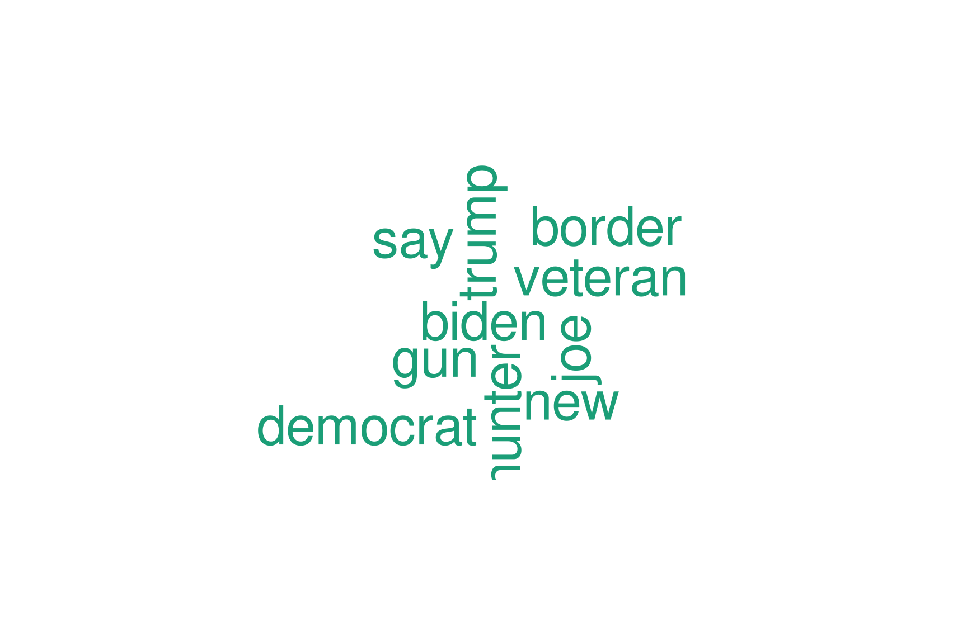
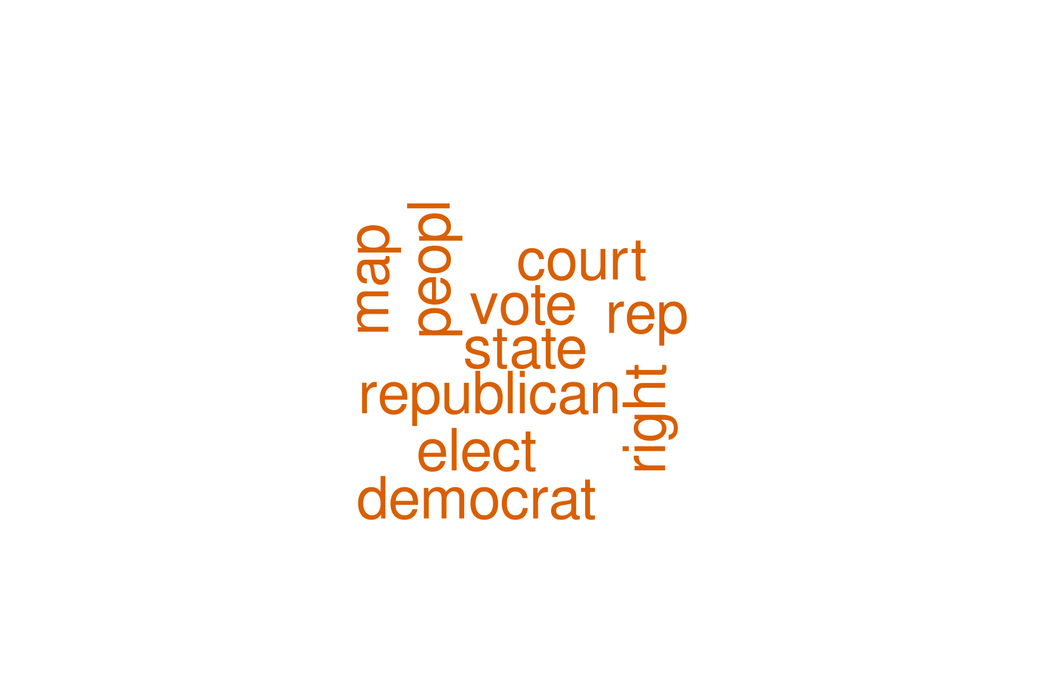
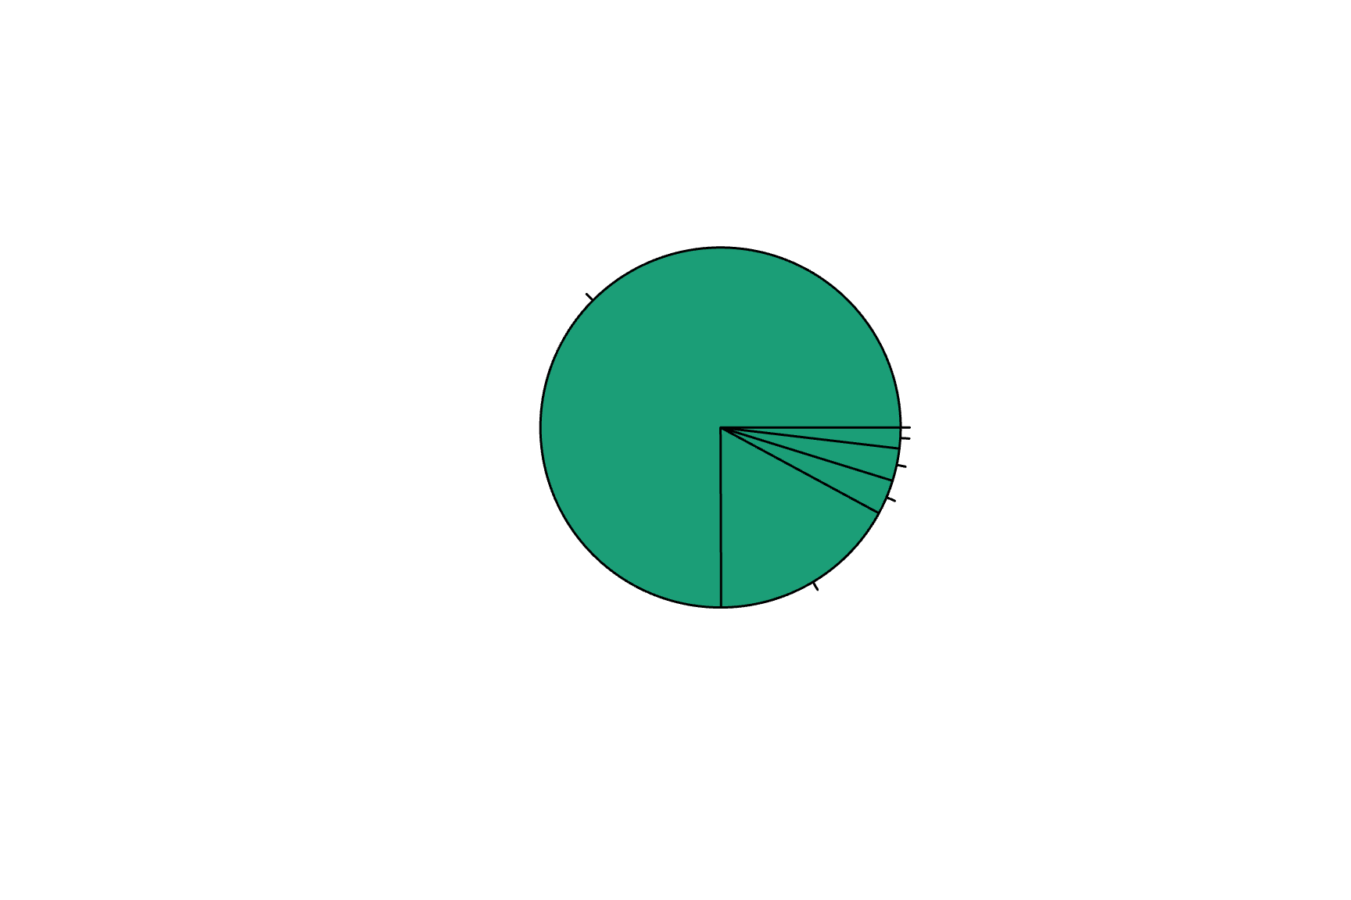

Slide 8
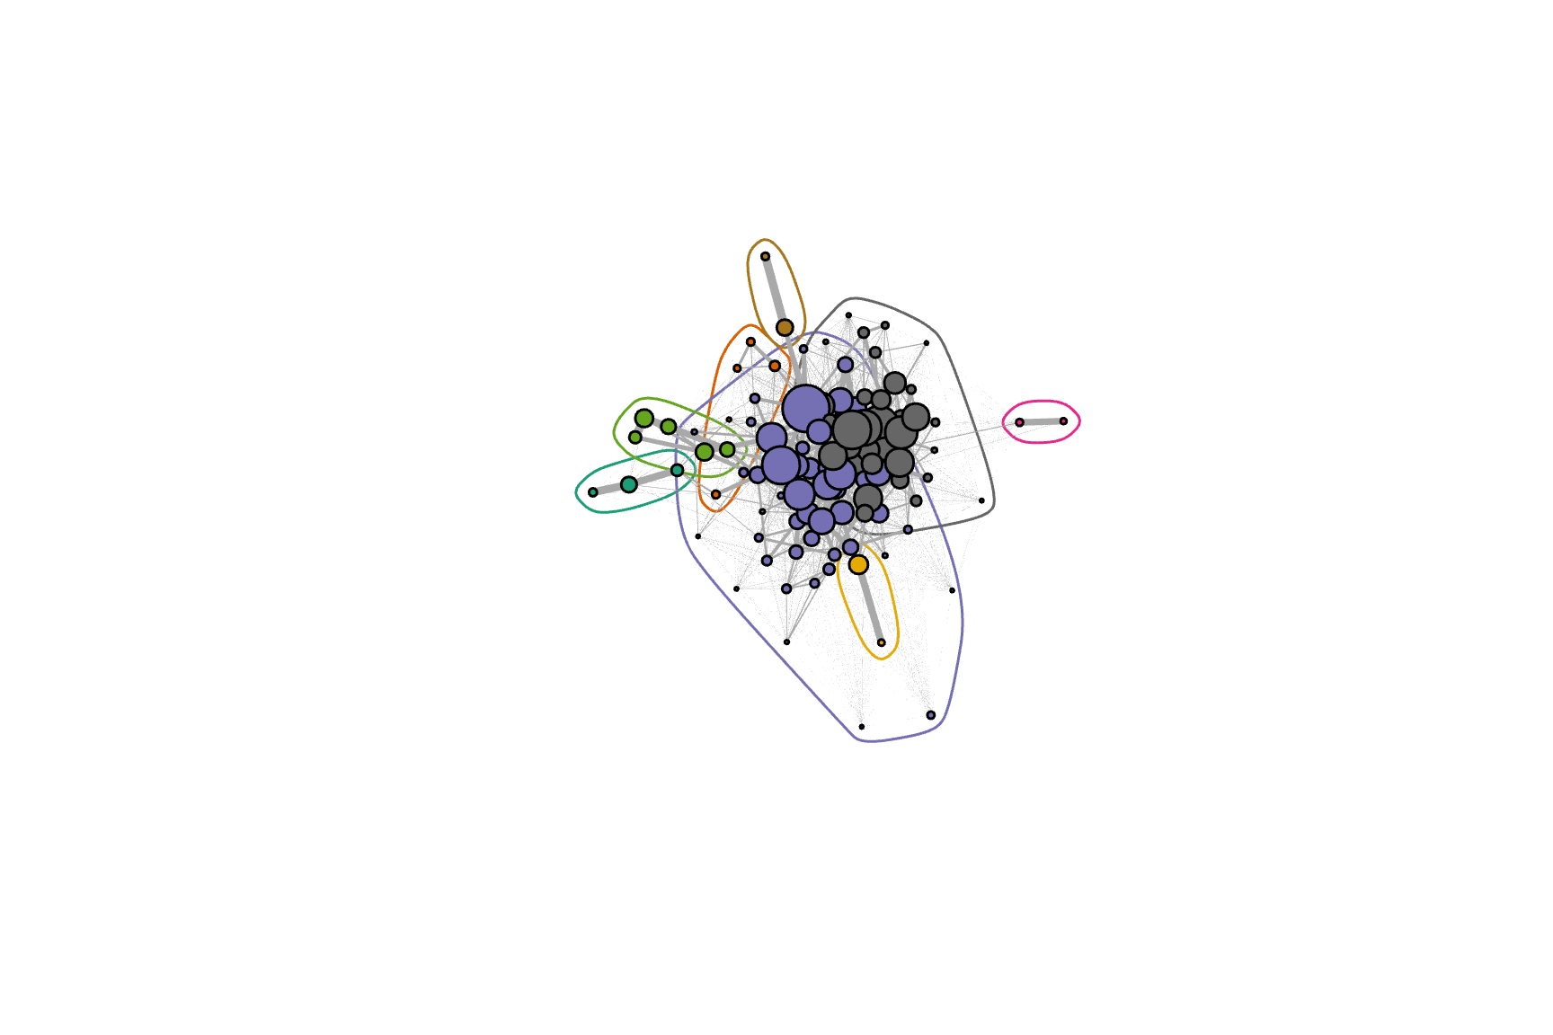
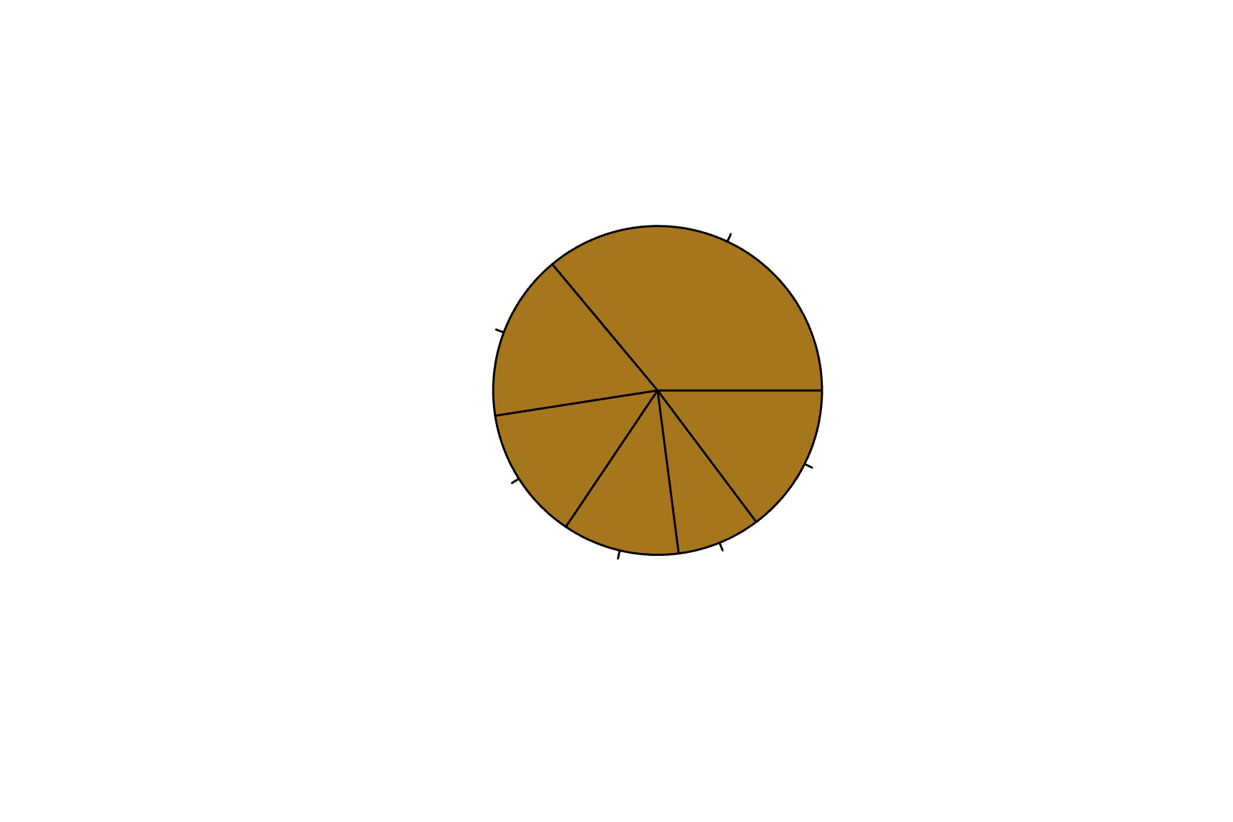
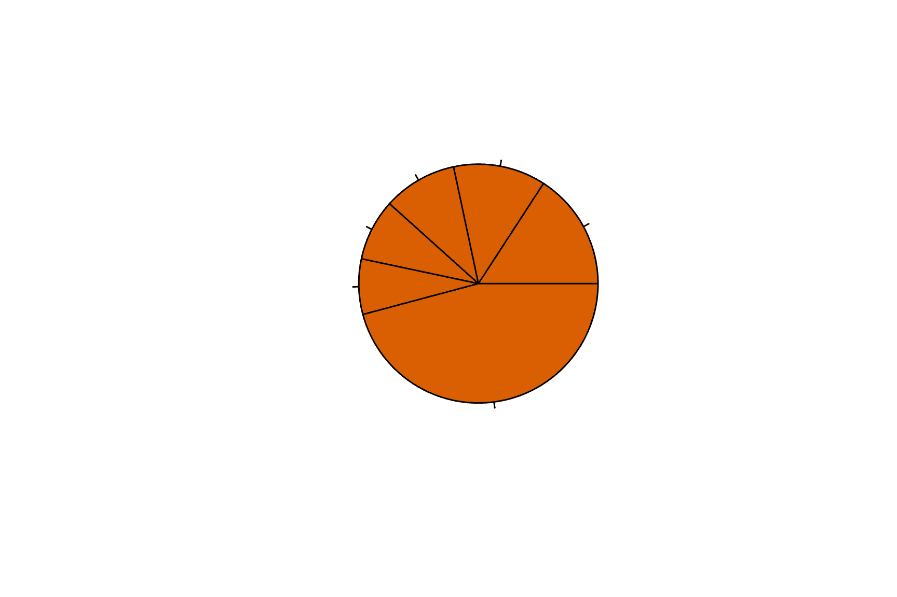
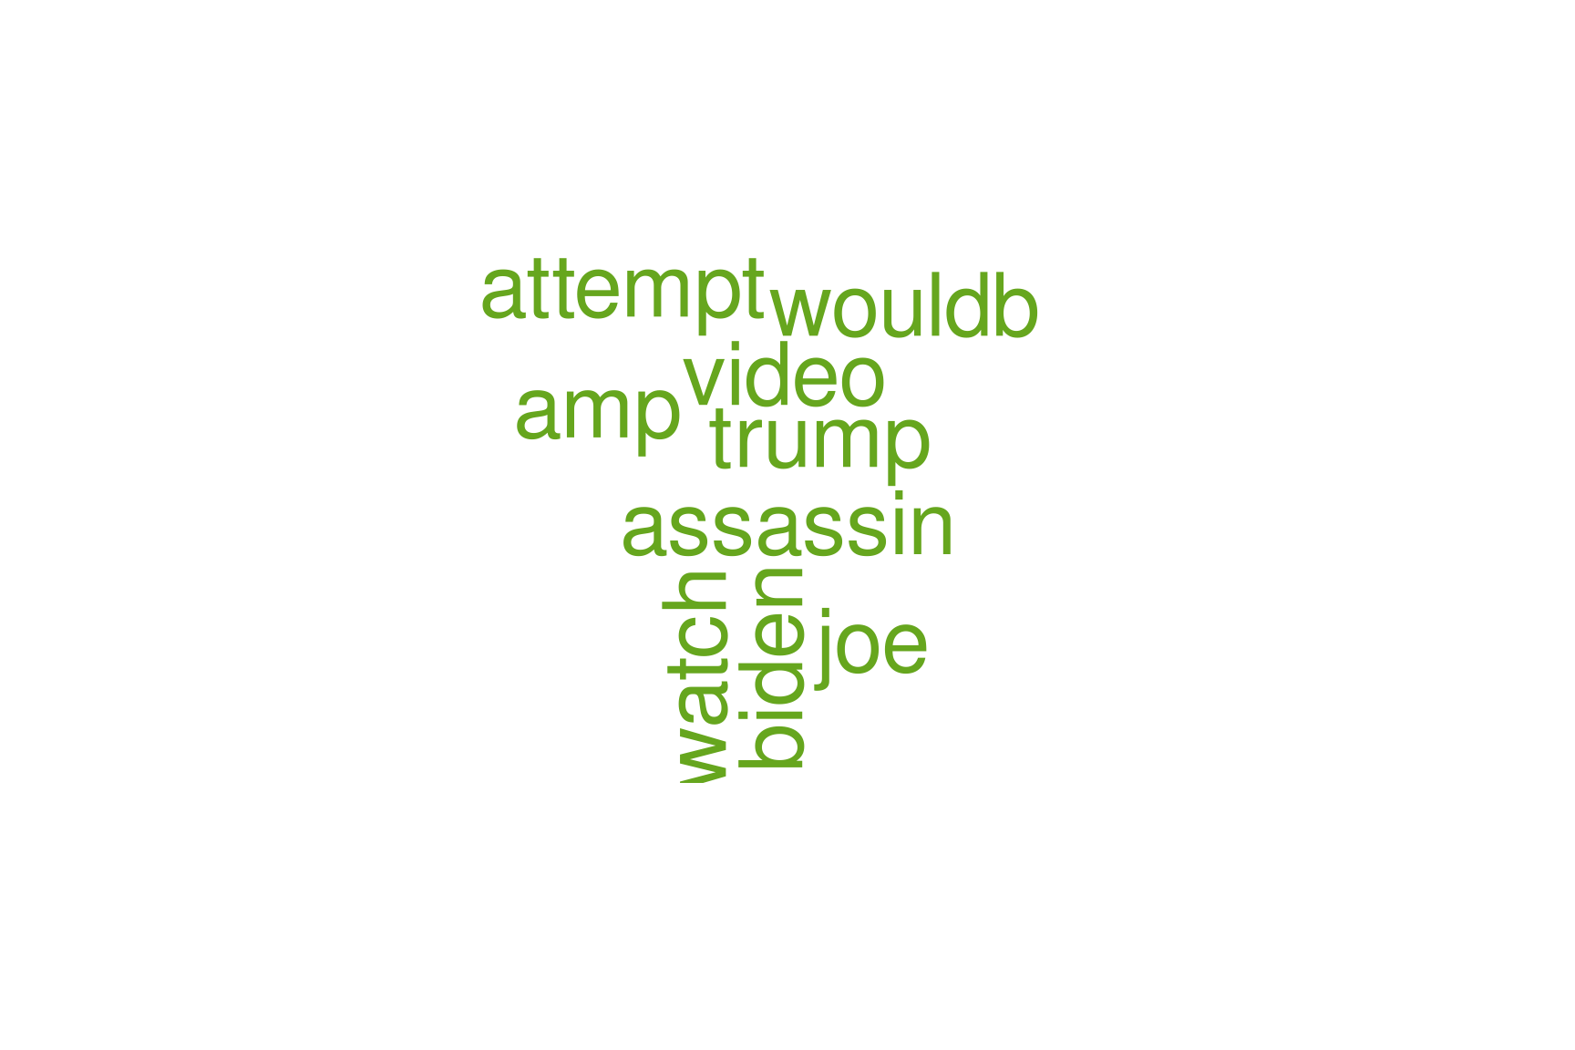
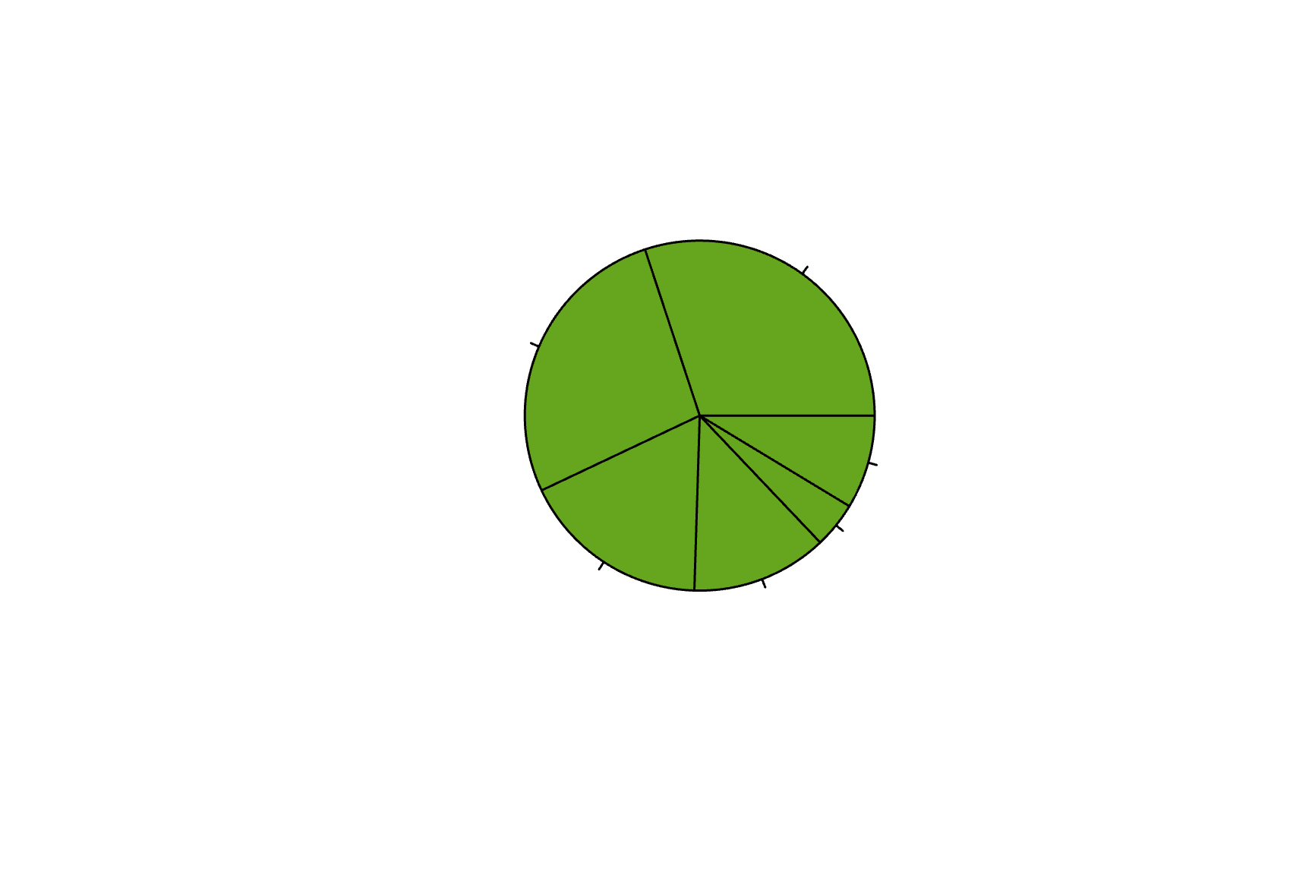
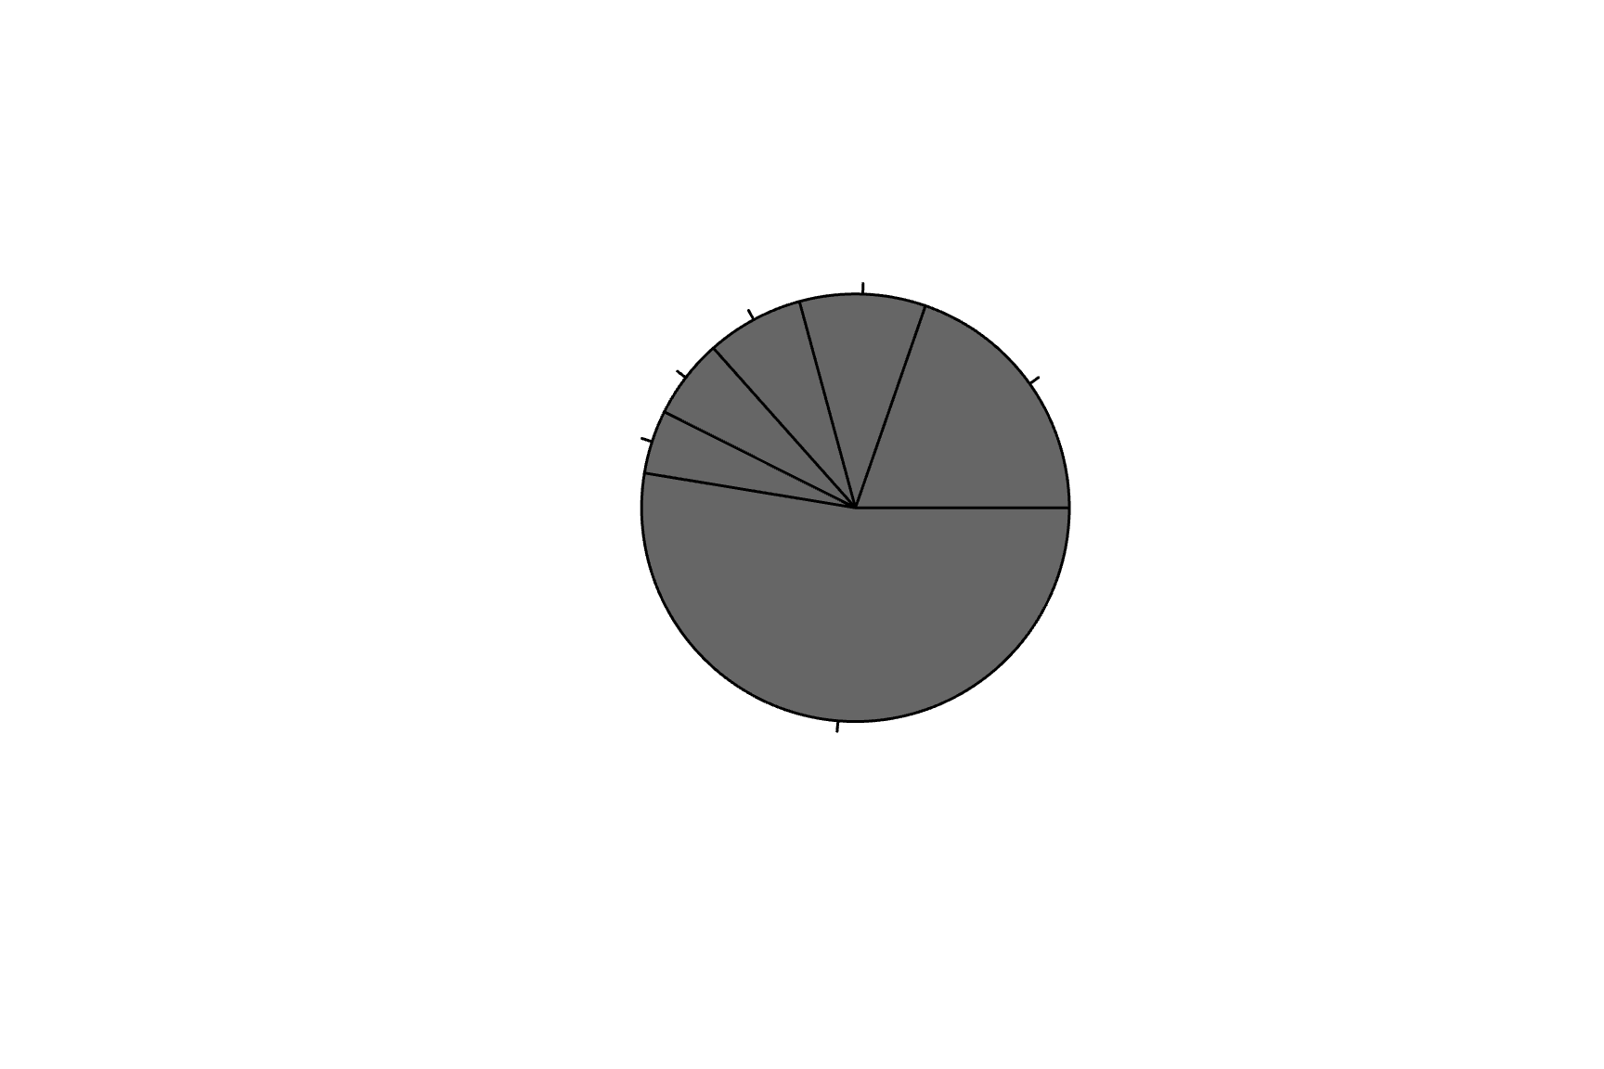

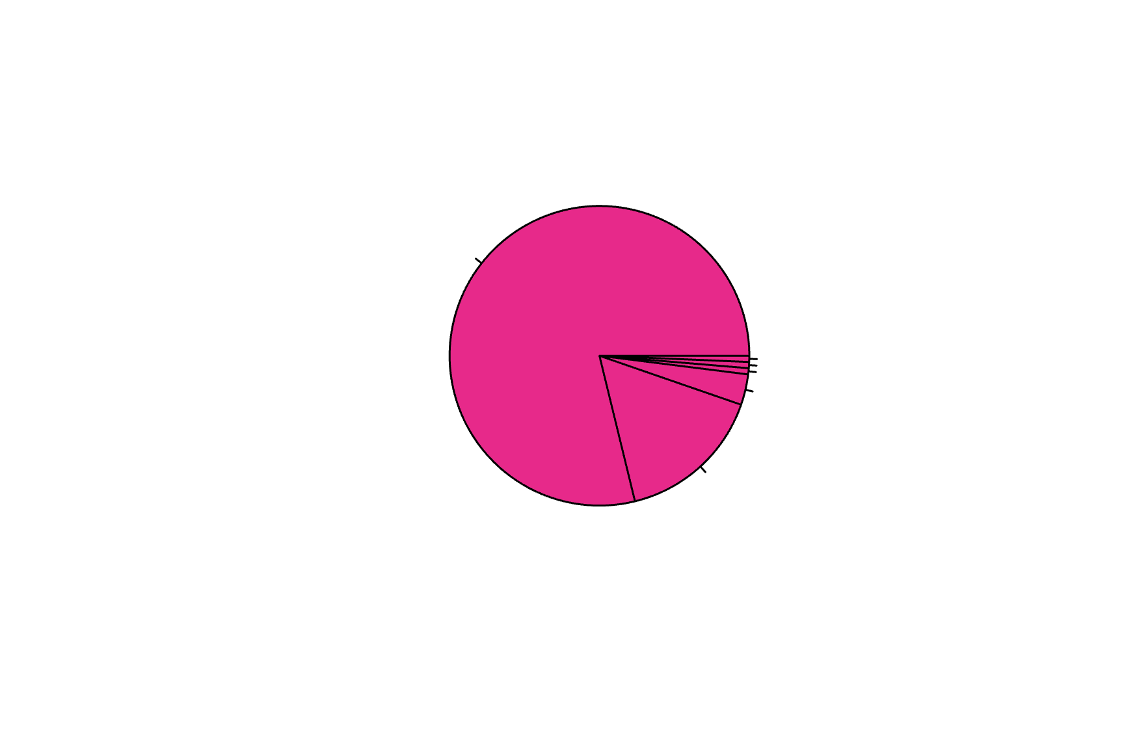
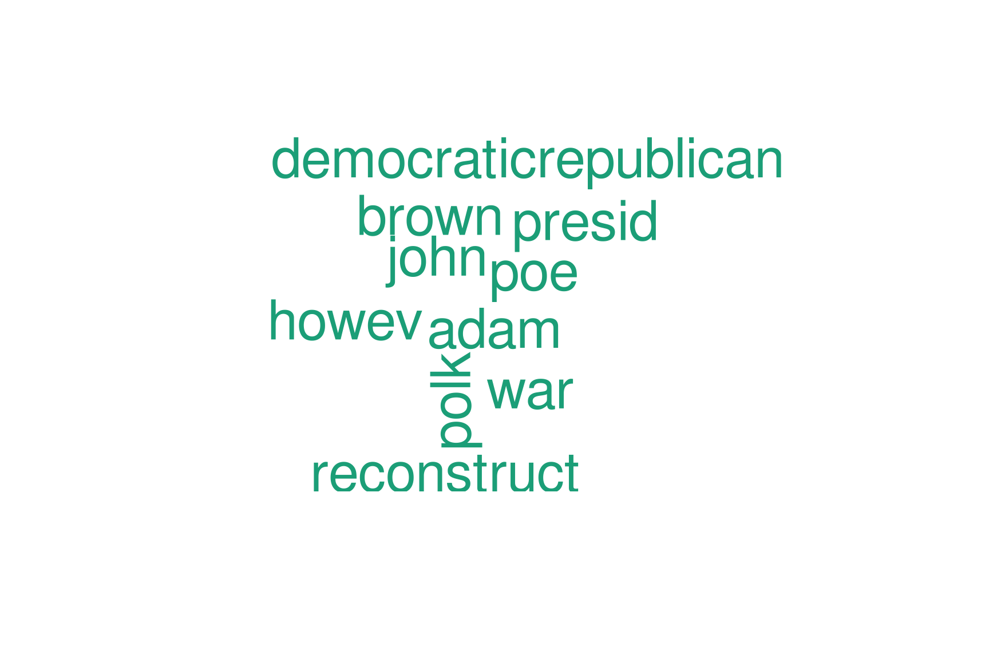
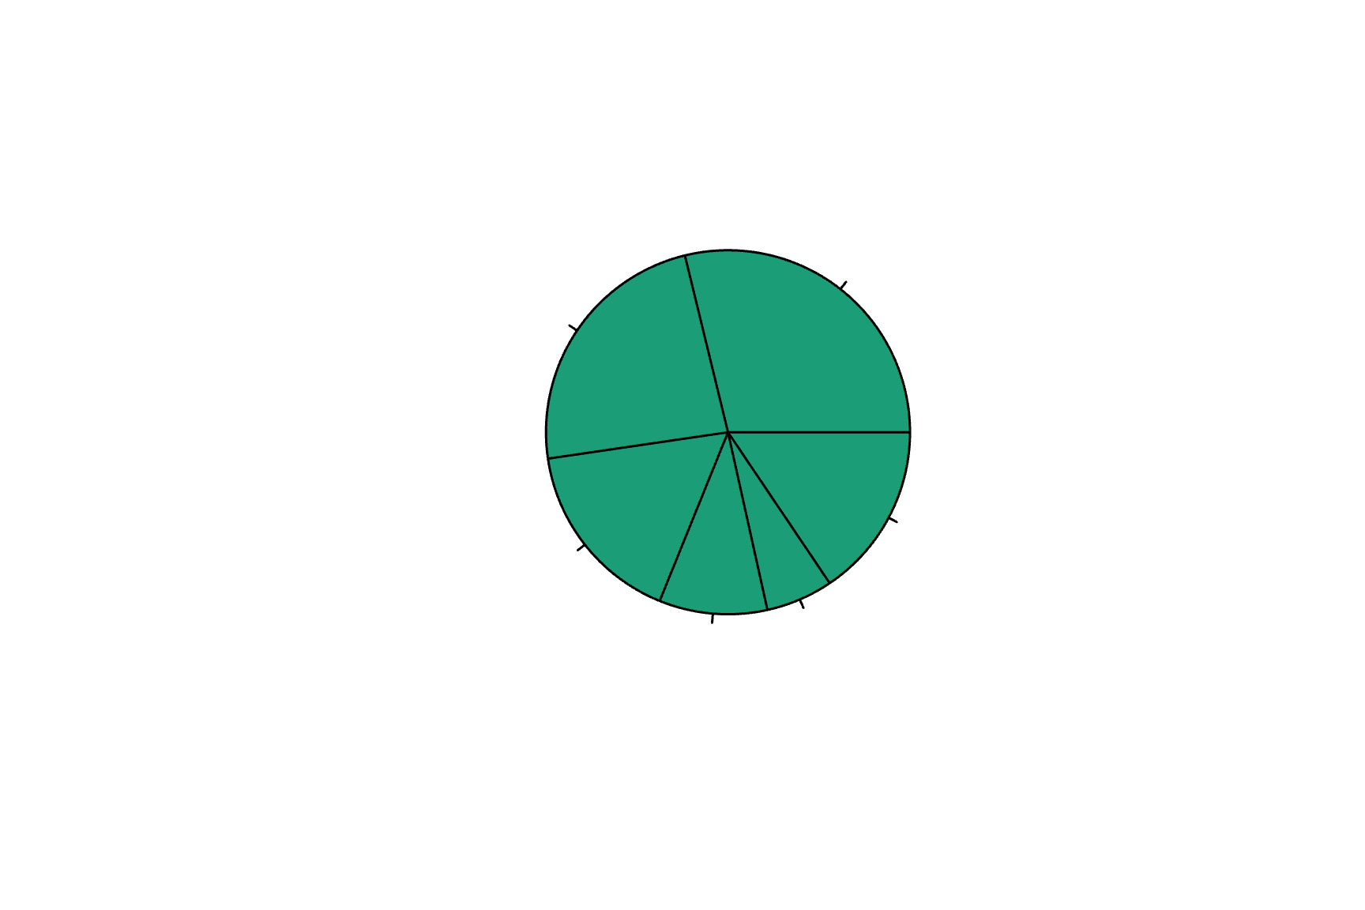
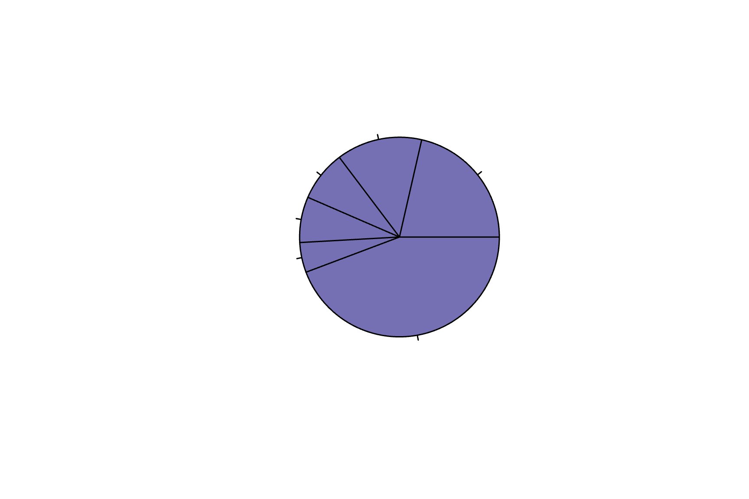
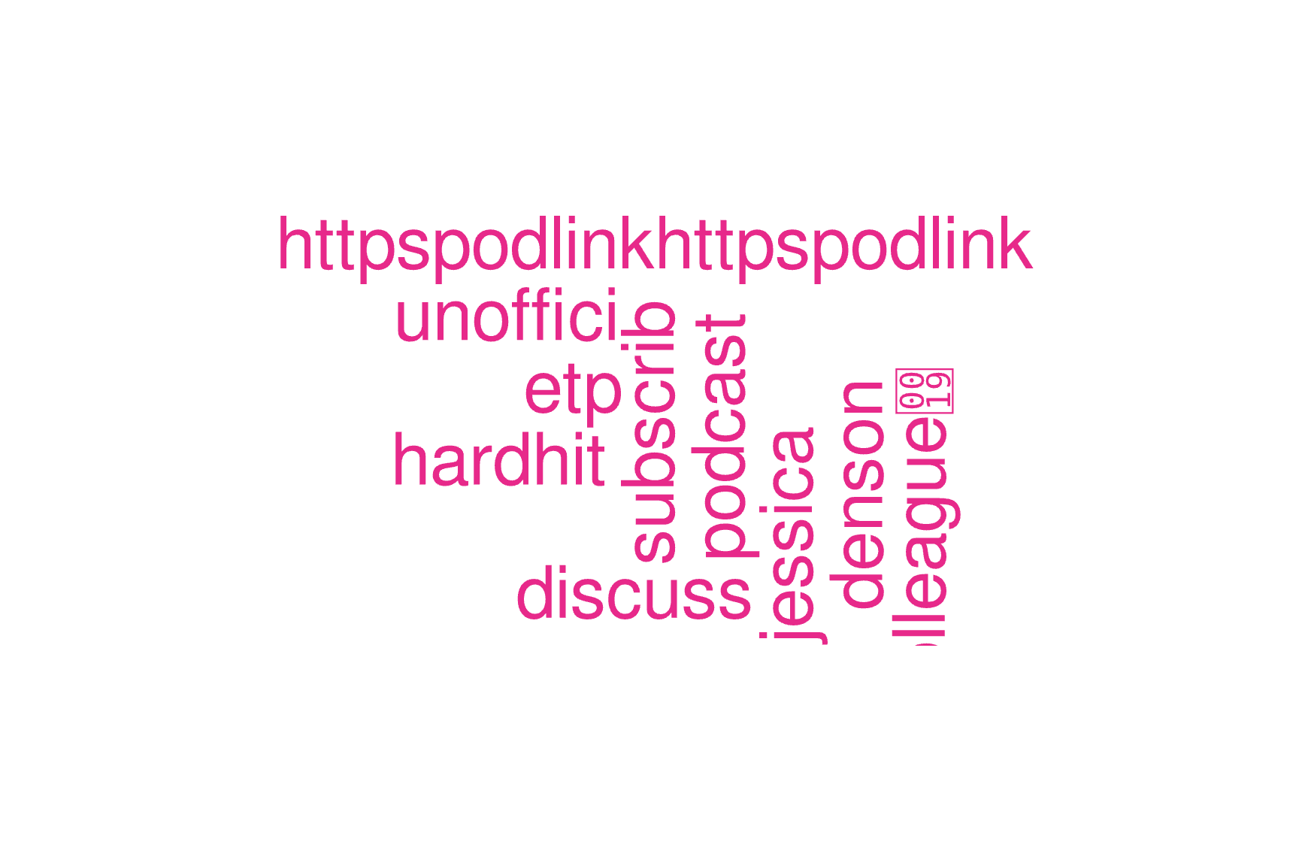
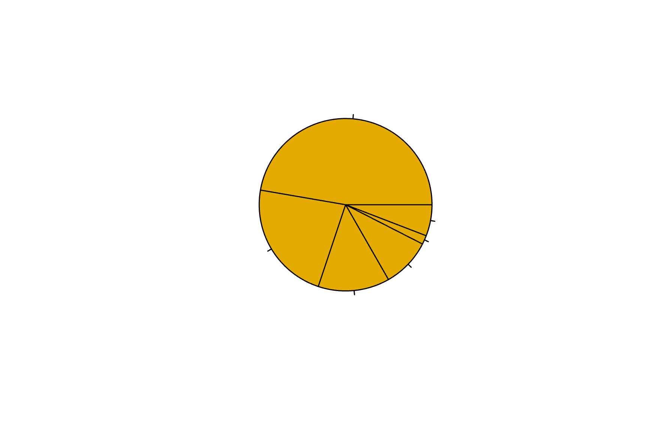
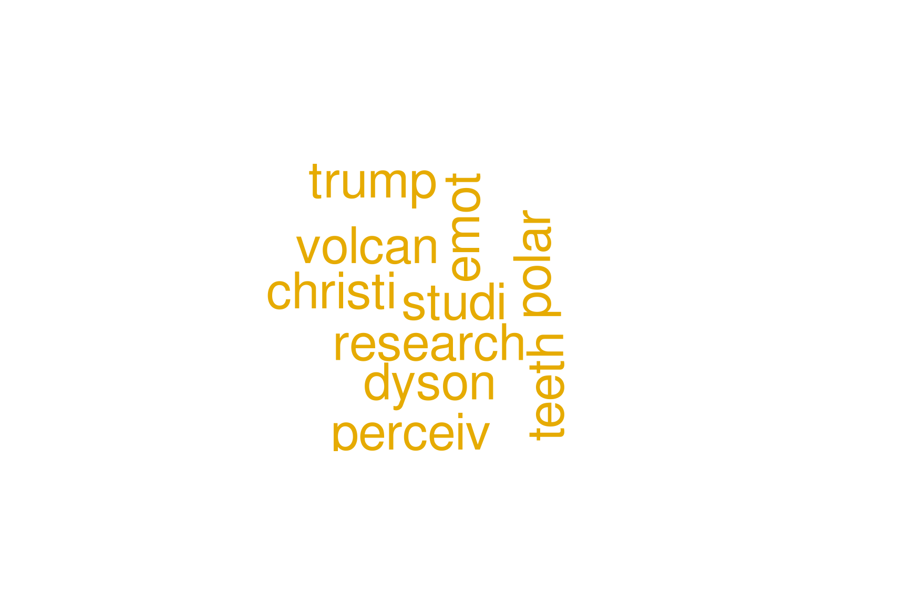

Slide 9
K-MEans clustering
1 | 2 | 3 | 4 | 5 | 6 | 7 | 8 | 9
6509 | 4 | 13 | 3 | 1 | 11 | 1 | 68 | 202
1 | 2 | 3 | 4 | 5 | 6
1 | 6664 | 1 | 237 | 13 | 12
Notes:
A noticeable imbalance in the clustering findings was discovered by K-means clustring
Which shows that numerous positngs were sparsley represented while a small number of subjects dominated the debate, such as Trump, election and people were often used

Slide 10
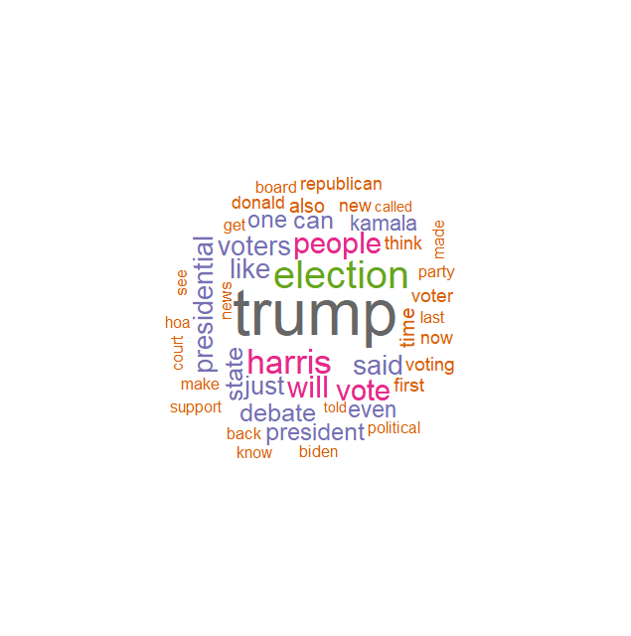
Year WOrd cloud
Notes:
The prominence of the term trump sugguest that the discussions are heavily centered around Donald trump
This could reflect recent news, public aperance or controversies related to him

Slide 11
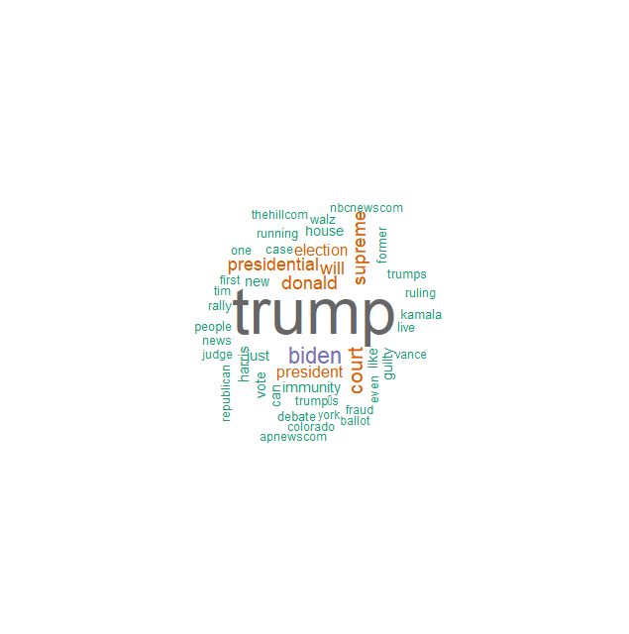
MOnth word cloud

Slide 12
Year before election
Month before election

Slide 13
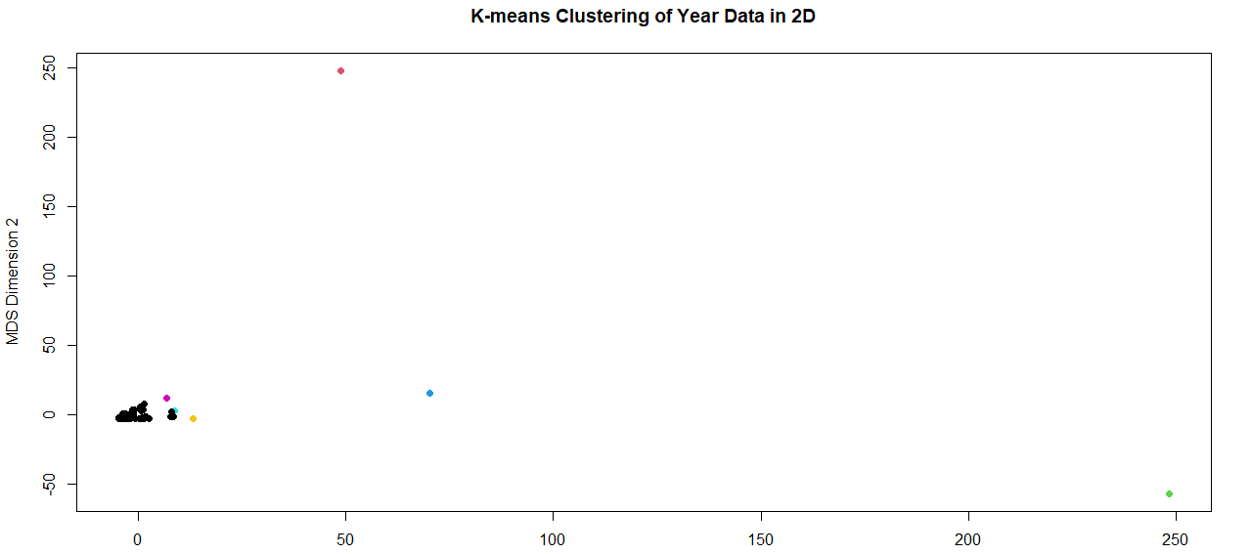
Year data
Notes:
Cluster Sizes:Cluster 1: 6509 posts (majority)
Clusters 2-9: Very few posts (e.g., 4, 13, 3, 1)
Interpretation: One main topic dominates; others are minor.

Slide 14
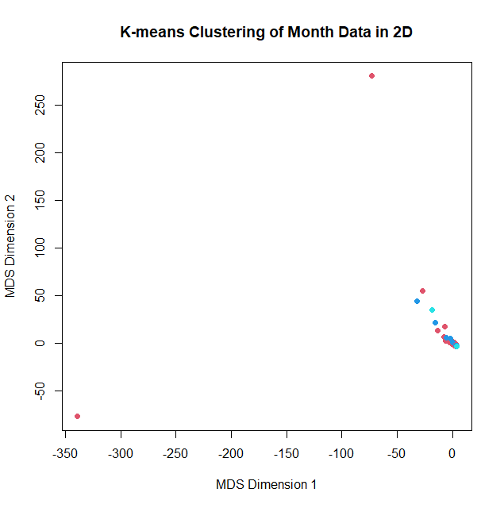
Month Data
Notes:
•Cluster Sizes:Cluster 1: 6645 posts (majority)
•Cluster 2: 272 posts
•Clusters 3-6: Very few posts (e.g., 1, 4, 14)
Interpretation: Similar pattern; one cluster has most discussions.

Slide 15
Conclusion
Notes:
There is a relationship between the number of comments and the election period
There are distinguishable communities with their own distinct focus. Some users play a key role in these communities
Overall, Trump is by far the most dominant topic across all posts and subreddits

